Slide 1
More Swing Components

Slide 2
Buttons
A button is a component that triggers an action event when clicked. Swing provides regular buttons, toggle buttons, check box buttons, and radio buttons
The common features of these buttons are generalized in javax.swing.AbstractButton

Slide 3
JButton http://download.oracle.com/javase/6/docs/api/javax/swing/JButton.html
JButton inherits AbstractButton and provides several constructors to create buttons.
Note: review the description, link (How to Use Buttons, Check Boxes, and Radio Buttons) to the Swing tutorial, the constructor and some common methods

Slide 4
WB - JButton
Click JButton (under ‘Components’)
Drop the button just below the description field
Change the name to ‘Next’

Slide 5
WB - Actions
Double-click the ‘Next’ button, or…
Right-click then select ‘Add event handler’ > ‘action’ > ‘actionPerformed’
Update the actionPerformed method:
System.exit(0);

Slide 6
Menus

Slide 7
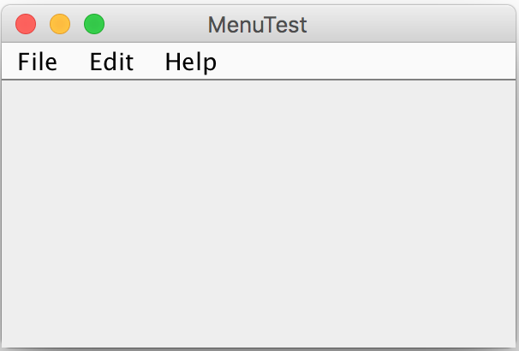
Building Menus... a quick run through…
Menus are constructed using the following steps
Create a menu bar and add it to the frame
Add menus to the menu bar
Add items to the menus
Attach actions to the menu items
Optionally
Add submenus to menus

Slide 8
1. Create a menu bar and add it to the frame
import javax.swing.*;
...
JMenuBar mainMenuBar = new JMenuBar();
setJMenuBar(mainMenuBar);
setJMenuBar is a JFrame method

Slide 9
2. Add menus to the menu bar
JMenu fileMenu = new JMenu("File");
mainMenuBar.add(fileMenu);
JMenu helpMenu = new JMenu("Help");
mainMenuBar.add(helpMenu);

Slide 10
3. Add items to the menus
import java.awt.event.*;
...
JMenuItem load = new JMenuItem("Load");
fileMenu.add(load);
JMenuItem save = new JMenuItem("Save");
fileMenu.add(save);
fileMenu.addSeparator();
JMenuItem exit = new JMenuItem("Exit",KeyEvent.VK_X);
JMenuItem about = new JMenuItem("About");
helpMenu.add(about);

Slide 11
Add submenus to menus (optional)
JMenu optionsMenu = new JMenu("Options");
fileMenu.add(optionsMenu);
JMenuItem option1 = new JMenuItem("Option 1");
optionsMenu.add(option1);
JMenuItem option2 = new JMenuItem("Option 2");
optionsMenu.add(option2);

Slide 12
4. Attach actions to the menu items
When a menu item is selected, it triggers an action event.
You must install an action listener for each menu item.
exit.addActionListener(new ActionListener() {
public void actionPerformed(ActionEvent e) {
System.exit(0);
}
});

Slide 13
WB - Menus
Select ‘Design’ for your JFrame
Open the “Menu” section if not open
Click “JMenuBar” and drop it to your frame
Click “JMenu” and drop it on the JMenuBar
Continue adding the required components

Slide 14
JCheckBox
A component that can be selected or deselected, and which displays its state to the user
By convention, any number of check boxes in a group can be selected

Slide 15
JRadioButton
Radio buttons are variations of check boxes. They are often used in the group, where only one button is checked at a time

Slide 16
Grouping Radio Buttons
ButtonGroup processColors = new ButtonGroup();
processColors.add(cyanButton);
processColors.add(magentaButton);
processColors.add(yellowButton);
processColors.add(blackButton);

Slide 17
JComboBox
A combo box is a simple list of items from which the user can choose. It performs basically the same function as a list, but can get only one value

Slide 18
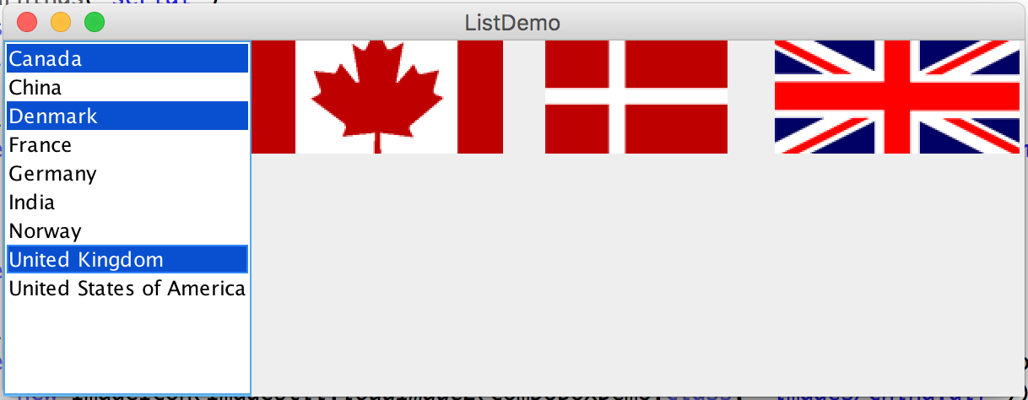
JList
A list is a component that performs basically the same function as a combo box, but it enables the user to choose a single value or multiple values
ListDemo

Slide 19
Window Events & Adapters
If you implement an interface, you need to implement ALL the methods that interface defines
Adapters implement all the methods, so you just need to override the ones you want
TestWindowEvent

Slide 20
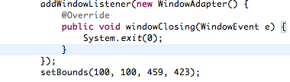
WB – Window Adapters
Right-click the frame
Select ‘Add event handler’ > ‘window’ > ‘window closing’

Slide 21
Exceptions in GUI Applications
There are several threads running to support a GUI application
A thread is launched to execute an event handler (e.g., the actionPerformed method for the ActionEvent)
If an exception occurs during the execution of a GUI event handler, the thread is terminated if the exception is not handled.
Java prints the error message on the console, but does not terminate the application. The program goes back to its user-interface-processing loop to run continuously
Therefore it is possible to miss the exception

Slide 22
Dialogs

Slide 23
Dialogs
From Wikipedia…
In a graphical user interface of computers, a dialog box is a type of window used to enable reciprocal communication or "dialog" between a computer and its user. It may communicate information to the user, prompt the user for a response, or both. A dialog box is most often used to provide the user with the means for specifying how to implement a command, or to respond to a question or an "alert”.
Dialog boxes are classified as "modal" or "modeless", depending on whether or not they block interaction with the software that initiated the dialog. The type of dialog box displayed is dependent upon the desired user interaction.

Slide 24
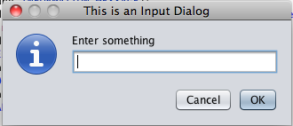
Simple Dialogs
The JOptionPane class contains several static methods to display simple message dialog boxes
static int showConfirmDialog(Component parentComponent, Object message, String title, int optionType, int messageType)
Brings up a dialog where the number of choices is determined by the optionType parameter, where the messageType parameter determines the icon to display.
static String showInputDialog(Component parentComponent, Object message, String title, int messageType)
Shows a dialog requesting input from the user parented to parentComponent with the dialog having the title title and message type messageType.
static void showMessageDialog(Component parentComponent, Object message, String title, int messageType)
Brings up a dialog that displays a message using a default icon determined by the messageType parameter.

Slide 25
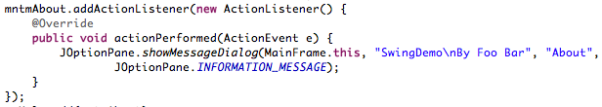
WB – Simple Dialogs
Right-click the ‘About’ menu item under the Help menu
Select ‘Add event handler’ > ‘action’ > ‘actionPerformed’

Slide 26
WB - Dialogs
Create a new dialog
New > Other… > JDialog
Put the CustomerDialog class in a ui subpackage
Generate the JDialog with OK and Cancel buttons
Add a new menu item ‘Customer’ to the File menu
Add an event handler to the ‘Customer’ menu

Slide 27
Move the code generated from WindowBuilder in the CustomerDialog class to the MainFrame class
move dialog.setDefaultCloseOperation(JDialog.DISPOSE_ON_CLOSE); to the CustomerDialog
mntmCustomer.addActionListener(new ActionListener() {
public void actionPerformed(ActionEvent event) {
try {
CustomerDialog dialog = new CustomerDialog(MainFrame.this);
dialog.setVisible(true);
} catch (Exception e) {
e.printStackTrace();
}
}
});

Slide 28
Passing a Customer
How do you pass a customer to the CustomerDialog?
CustomerDialog dialog = new CustomerDialog(MainFrame.this);
dialog.setCustomer(customer);
public void setCustomer(Customer customer) {
idField.setText(Long.toString(customer.getId()));
...
joinedDateField.setText(customer.getJoinedDate() .format(DateTimeFormatter.ofPattern("yyyy-MM-dd")));
}

